Slide 2
The IMPORTANCE OF MENTORSHIP Presented by: George L. JONES, M.S.E.D.

Slide 3
OBJECTIVES
To explain the importance of mentorship.
To discuss the importance of Retention within the organization.
To develop some realistic strategies for Retention.

Slide 4
What IS WRONG WITH THIS PICTURE?

Slide 5
ACTIVITY
ARE YOU OVER THE AGE OF 65???

Slide 6
1. Gives a person a connection to the organization. 2. allows you the opportunity to develop relationships. 3. gives the person the opportunity to develop their own skills. 4. HELPS WITH RETENTION. 5. BUILDS A CULTURE OF KNOWLEDGE SHARING and COLLABORATION. 6. INCREASE PROFITS.
WHY IS MENTORING IMPORTANT?

Slide 7
WHAT DOES MENTORING LOOK LIKE?
MAKING TIME
LISTENING
THEY SHARED THEIR IDEAS AND EXPERIENCE BUT DIDN’T TELL THE INDIVIDUAL WHAT TO DO
HELP A PERSON TO REALIZE WHAT THEY ARE GOOD AT

Slide 8
WHO SHOULD WE BE MENTORING?
WHAT AGE GROUP IS NOT REPRESENTED?

Slide 9
GENERATIONS
Boomers 2 (60-69)
Gen X (44-59)
Millennials (28-43)

Slide 10
GENERATION Z
They love to travel
They prioritize saving money
They are self-driven
They strive for diversity
They are future-orientated
They are social media-driven

Slide 11
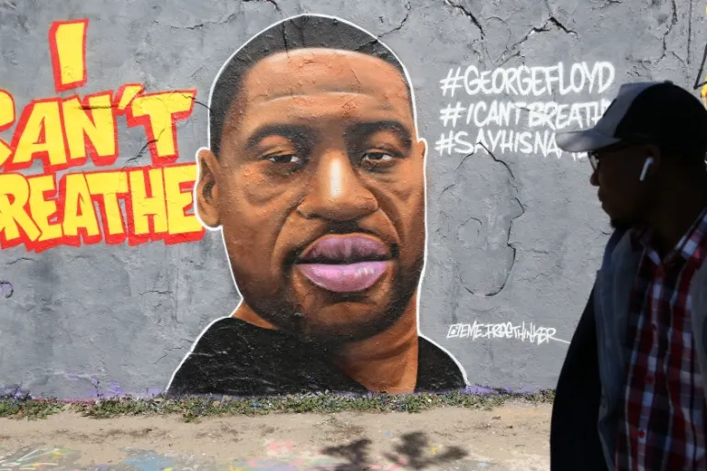
GEORGE FLOYD

Slide 12
SHARE ANY EXPERIENCES
MENTOR OR MENTEE

Slide 13
WHAT CHANGES CAN WE MAKE?

Slide 14
THANK YOU
WILLIE J. MINNIFELD TRAINING AND DEVELOPMENT DEPARTMENT

