Slide 1
Black, Strong, and Mentally Healthy.... Mental Health Awareness through the African-American lens
A Chat with Dr. Chrishawn Finister

Slide 2
Who am I?
Native Buffalonian
Marian and Christopher Mitchell’s daughter
Jeremy Finister’s wife (12 + years)
Lennox (age 9) and Bellamy’s (3) mother
Practicing School Psychologist (14 + years)
Owner and Founder of Your Joy Psychological Assessments
Notes:
Now Live in the Dallas/ Ft. Worth area
People Often think I do therapy… not in the least… some psychs do therapy but my job is to identify disabilities through testing. I am trained in assessments to identify learning disabilities (e.g. dyslexia), ADHD, autism, depression, and anxiety…specifically, how those factors may or may not impact a child from learning.

Slide 3
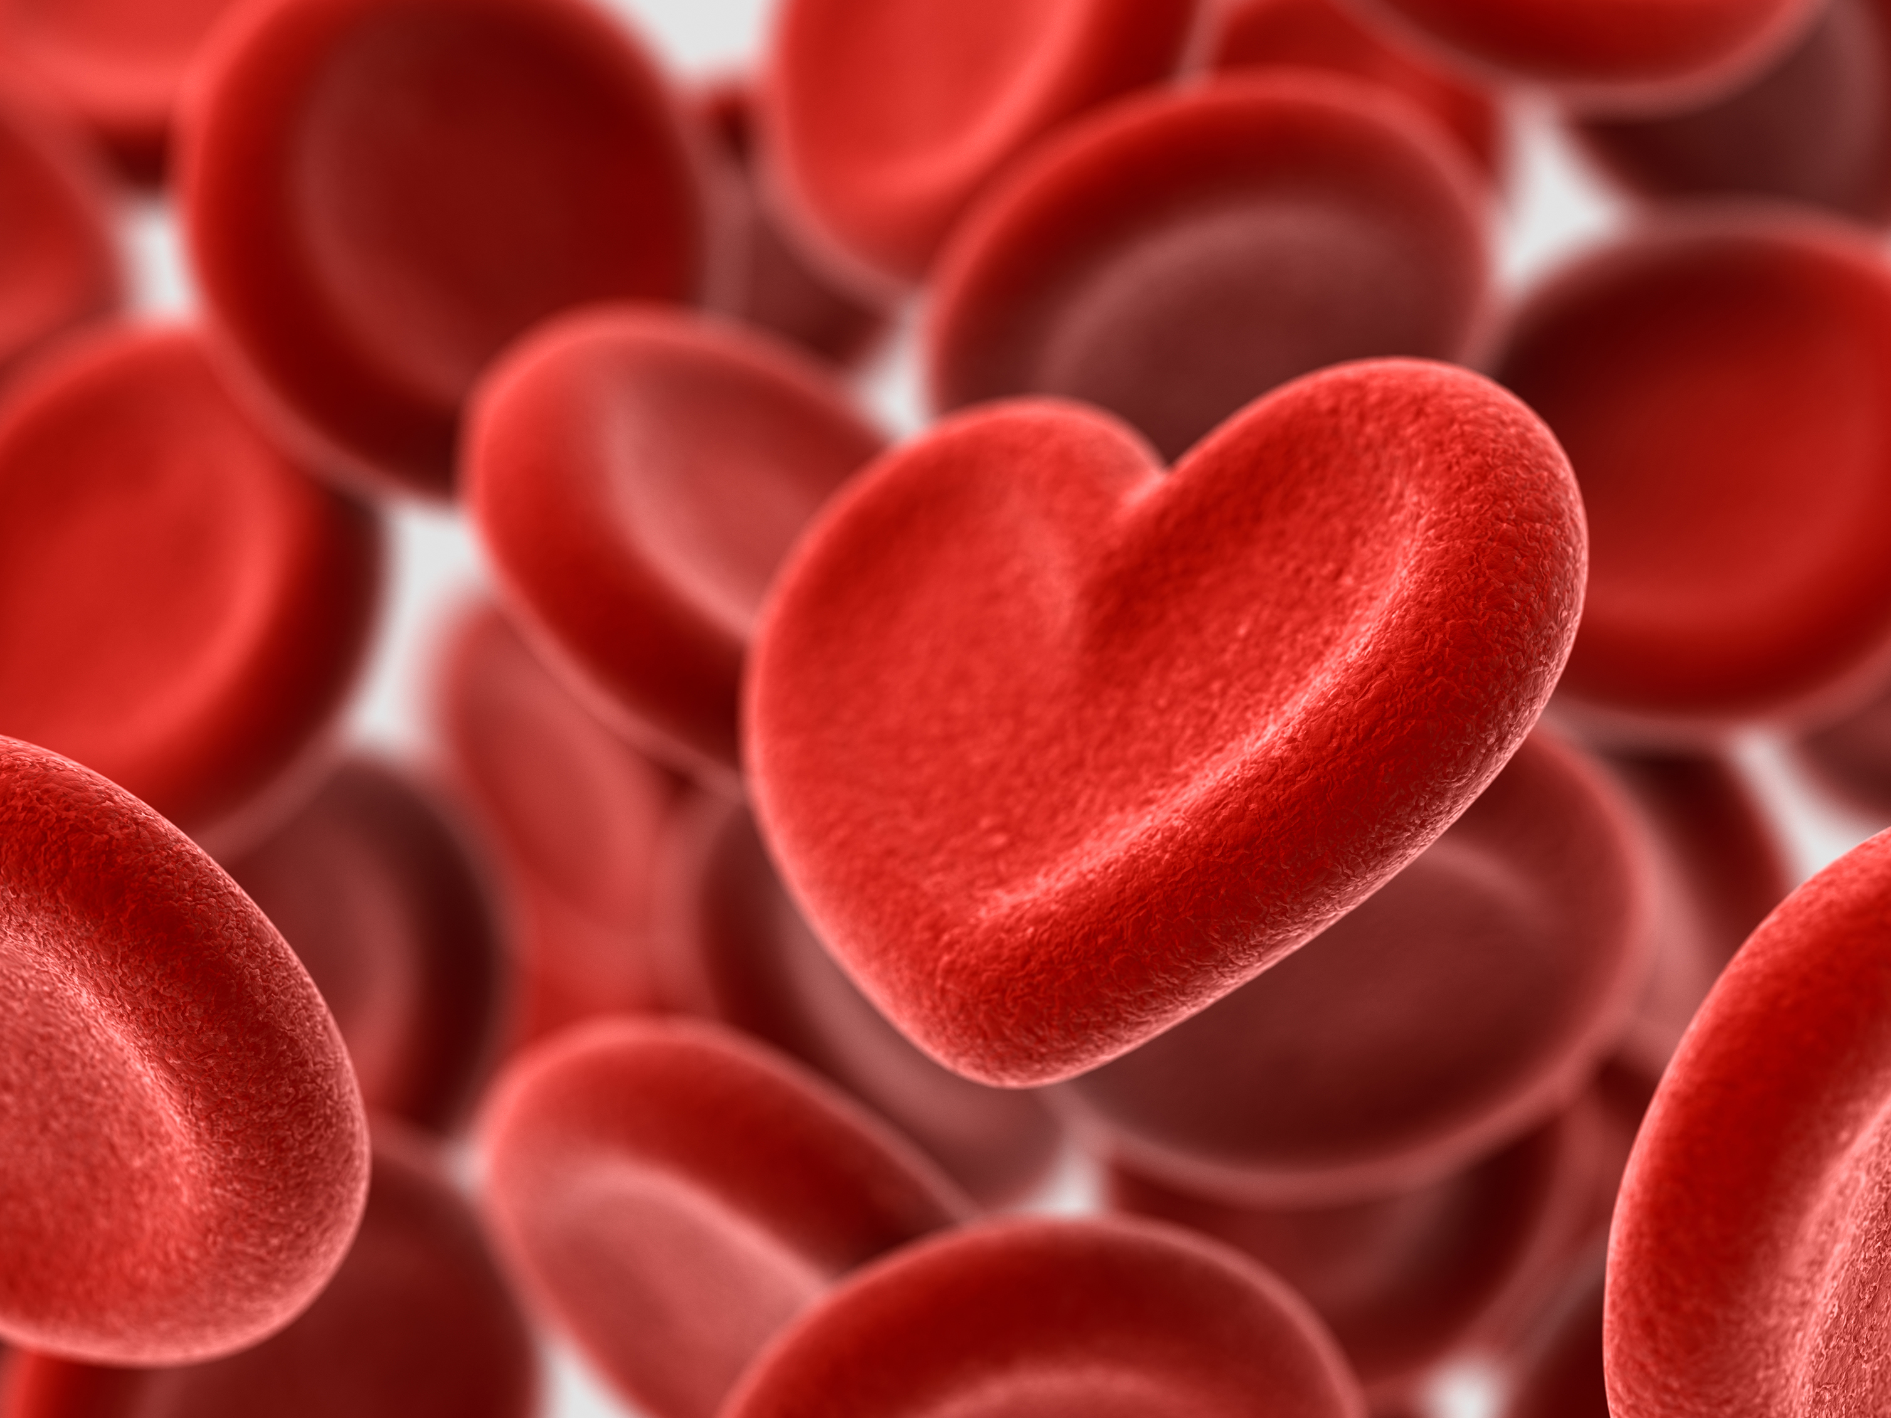
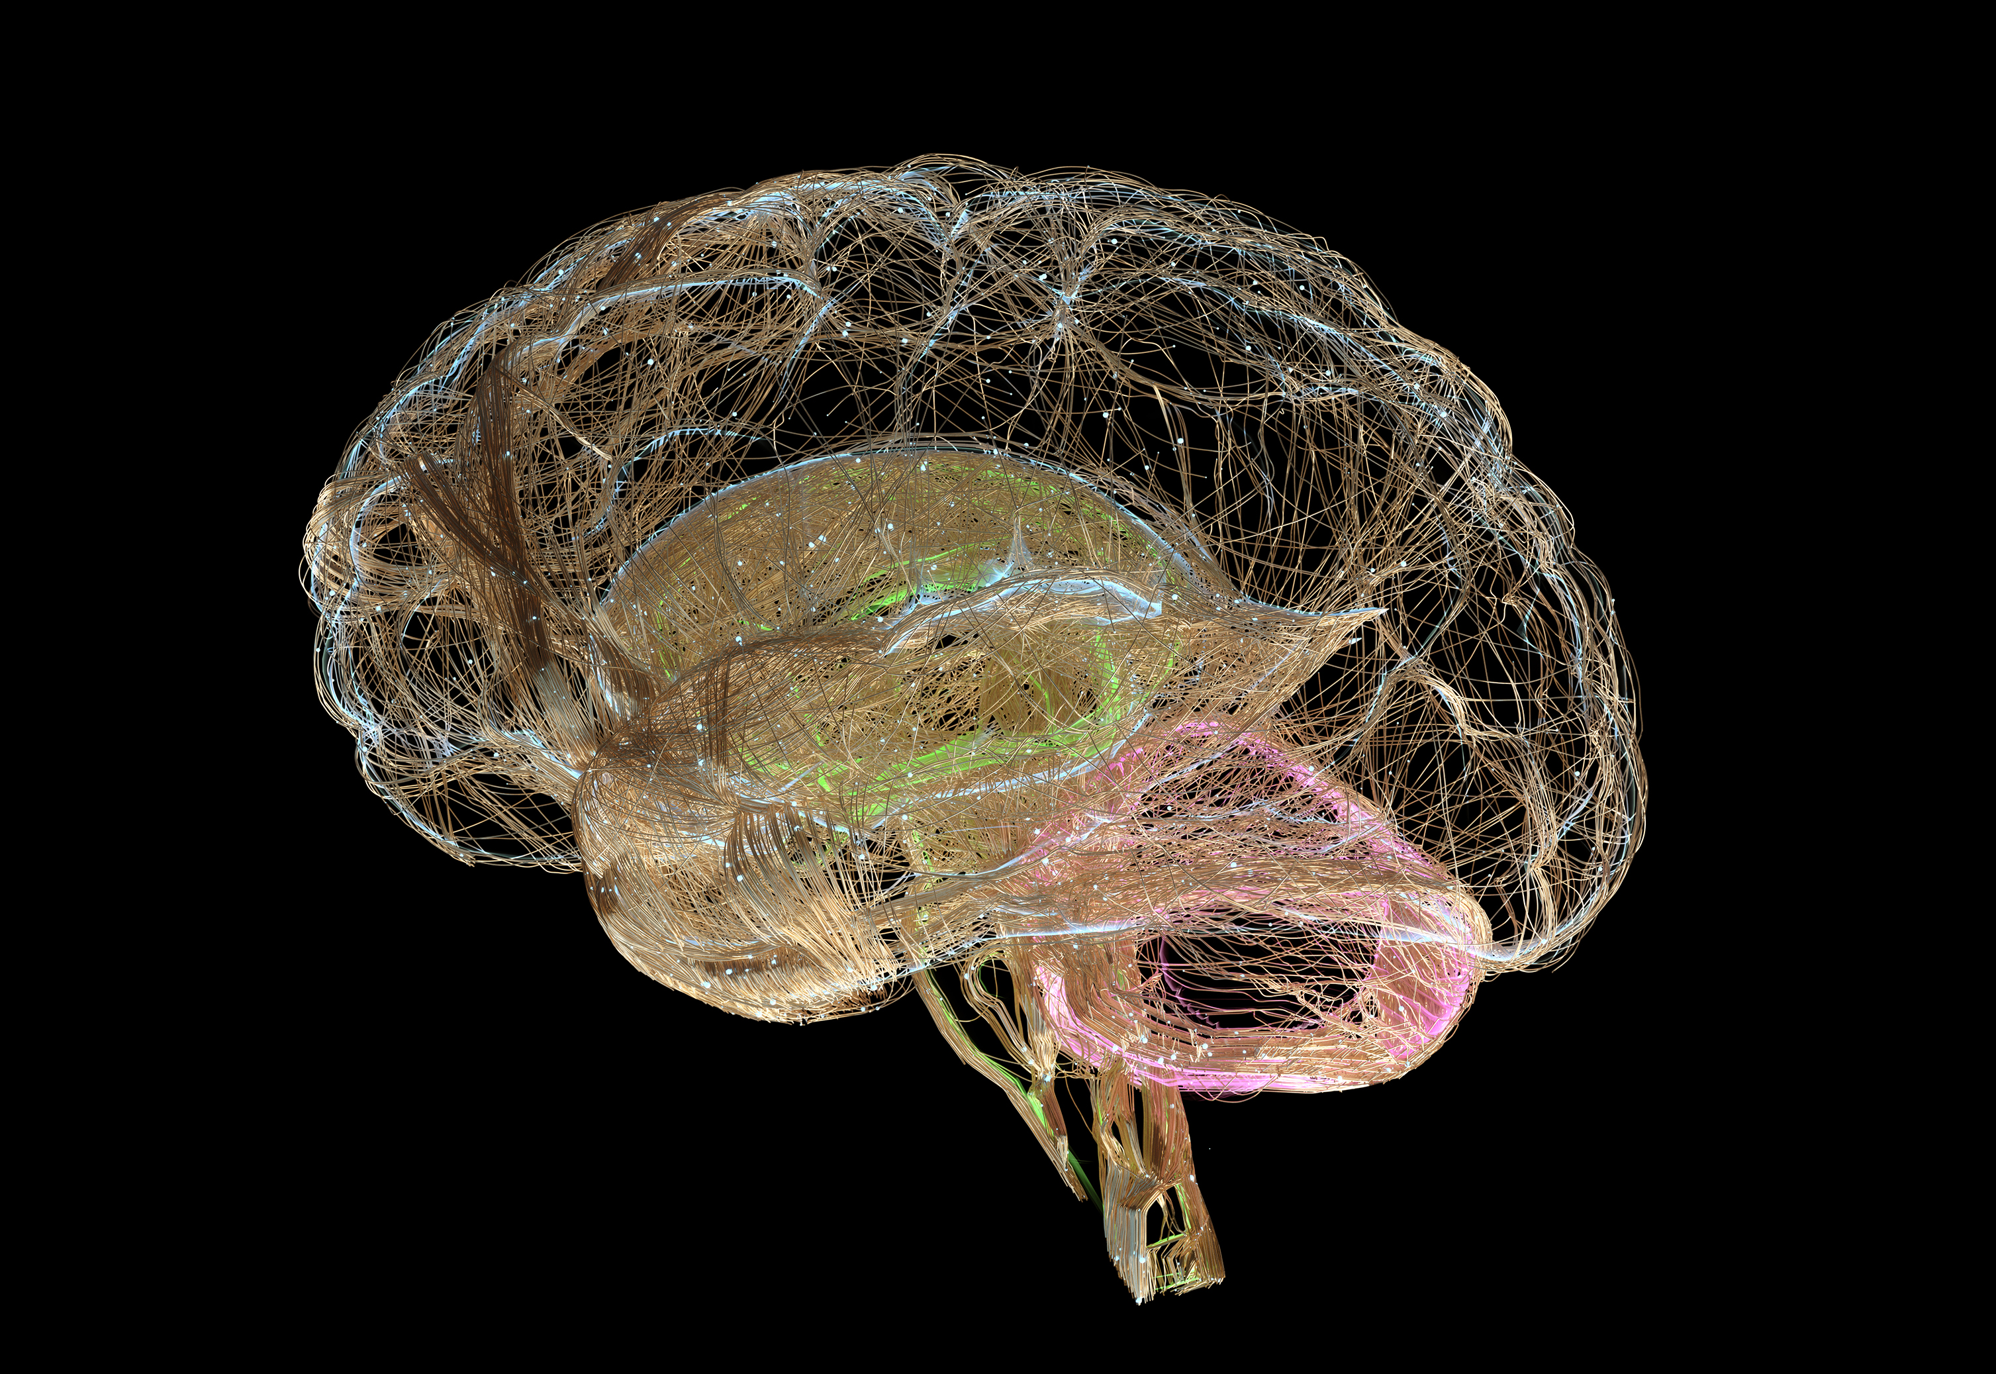
Which Organ Is It?
Heart
Brain
Notes:
Very quickly… let me give you a crash course in physiology. When people are making decisions….. Or sharing their thoughts…. I often here them say things like... I followed my heart. Or in my heart I knew….. While the heart is an extremely important organ… all of decisions, behavior, and emotions originate with chemicals in the brain. These chemicals are released by neurotransmitters.

Slide 4
What is Mental Health?
“Mental Health is a state of mental well-being that enables people to cope with the stresses of life, realize their abilities, learn well and work well, and contribute to their community.”
It’s a critical part of overall wellness. Importantly, mental health is more than just the absence of mental disorders or disabilities.
Peak mental health is about not only avoiding active conditions, but also looking after ongoing wellness and happiness. It also encompasses resilience – the ability to bounce back from difficult situations, even if none are currently happening.

Slide 5
Neurotransmitters Have Big Jobs!!!
a chemical substance that is released at the end of a nerve fiber by the arrival of a nerve impulse and, by diffusing across the synapse or junction, causes the transfer of the impulse to another nerve fiber, a muscle fiber, or some other structure.
This Photo by Unknown Author is licensed under CC BY

Slide 6
What do Neurotransmitters Control?
-Muscle Movements
Sleep/Wake Cycles
Eating
Sex Drives
Mood
Pain Processing
Pleasure Seeking Behaviors
Attention & Focus

Slide 7
Equilibrium
Balance = Healthy
Unbalanced
This Photo by Unknown Author is licensed under CC BY
Notes:
In a world of more… and more and more… sometimes it is easy to forget ENOUGH. Not too little… not too much. Our brain is no different. We need just ENOUGH of our brain chemistry to optimally function.

Slide 8
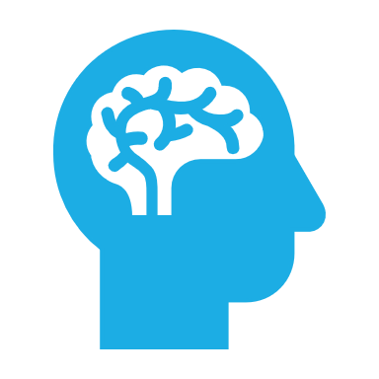
What happens when the brain is unbalanced?
Depression
Anxiety
Schizophrenia
Parkinson’s
Huntington’s Disease
Alzehimers
Attention Deficit Hyperactivity Disorder (ADHD)
Obsessive Compulsive Disorder
Post Traumatic Stress Disorder (PTSD)
Notes:
What does it look like when the brain is unbalanced in an individual’s life? Mental Health Disorders

Slide 9
How Can the Brain become Unbalanced?
TRAUMA
a pervasive and often overlooked problem that can significantly impact your health.
Even though researchers understand the short-term effects of trauma, the long-term effects on the brain can be more subtle and difficult to understand.
Notes:
Increased Heart Rate and Blood Pressure……Heightened Senses….. Suppression of Non-essential Functions…. Release of Energy Stores…..

Slide 10
The African-American Experience and the Elephant in the Room
According to the American Psychological Association, racial trauma can result from direct experiences of racism, as well as insidious occurrences that add up over time.

Slide 11
Black is Beautiful but….
Major experiences of racism include physical and verbal attacks, while indirect stressors include seeing videos of police brutality on social media or being the target of subtle putdowns.
Racial trauma can also result from intergenerational trauma: traumatic stress passed from one generation to the next.
Stress reactions to trauma are normal responses to abnormal situations. A person’s response to a trauma depends on the individual, the type of trauma, the meaning of the trauma, as well as cultural factors.
People who have experienced multiple traumas throughout their lives are at greater risk for experiencing another trauma. They also experience more severe symptoms and longer lasting effects.
Researchers believe that racial trauma is one of the reasons Black people in some communities have higher rates of PTSD (8.7%) compared to white people (7.4%).
Studies also show that African American youth are at risk of developing PTSD: Nearly 65% of African American youth report traumatic experiences, compared to 30% of their peers from other ethnic groups.
Notes:
They want our Rhythm but not the blues…… The history of slavery…..followed by Jim Crow Laws.. Followed by Civil Rights… followed by the crack epidemic…. Followed by…..
Many do not realize stress can be passed to the fetus in utero
If you identify as African American…. I urge you to take a moment and think about your own family and history. What trauma did you witness? How was that trauma handled? Could that trauma had been handled more efficiently?

Slide 12
More Hard Truths…
Burdens of Single Motherhood
30% of Black families led by single mothers compared to 9% of white families
Less than half of all Black Americans with a mental disorder get the treatment that they need.
Suicide is the third leading cause of death among African Americans ages 15 to 24.
Mental health services can be expensive, and the wait for actual results is long. For many African Americans, mental health help is too costly to afford.
< 2% of psychologists are black
Notes:
Making Time for Mental Health Care
Historical institutional Mistrust

Slide 13
Encouragement…
Notes:
I don’t want to end on a negative note….. But there is hope! The fact that today we brought awareness to mental health…. Even if you cannot find a Black mental health professional….find a culturally competent one.

Slide 14
Brain Balancing Ideas…..
Acknowledging when and If you are struggling
Seeking out available resources (i.e. school counselors, school psychologists, therapists)
Knowing when you need to take a step back
Keeping your physical body active (i.e. exercise)
Taking Medicine if and as prescribed by medical practitioners
Notes:
It is OK…..to not be ok… here are some simple things you can do to help keep your brain balanced.

Slide 15
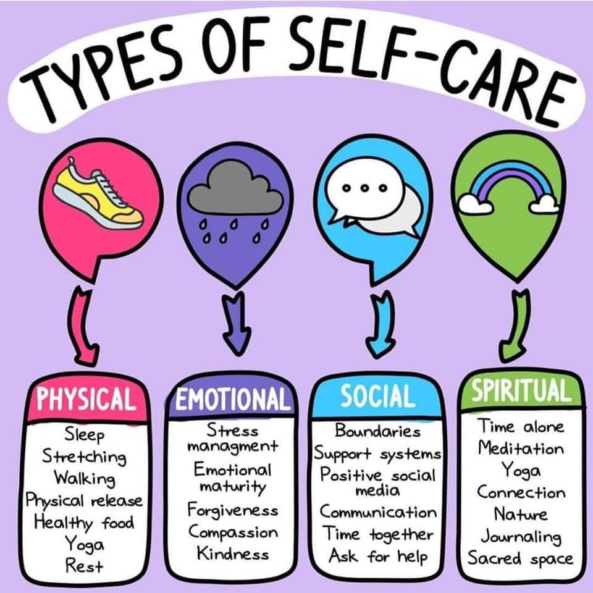
What works for you?
This Photo by Unknown Author is licensed under CC BY

Slide 16
Questions???

Slide 17
Thank you so much for your Time!!
www.yourjoypsych.com
drfinister@yourjoypsych.com

